Slide 1
Isaiah 11:1-16
(English Standard Version)
7 Slides

Slide 2
11 There shall come forth a shoot from the stump of Jesse,
and a branch from his roots shall bear fruit.
² And the Spirit of the Lord shall rest upon him,
the Spirit of wisdom and understanding,
the Spirit of counsel and might,
the Spirit of knowledge and the fear of the Lord.
³ And his delight shall be in the fear of the Lord.

Slide 3
He shall not judge by what his eyes see,
or decide disputes by what his ears hear,
⁴ but with righteousness he shall judge the poor,
and decide with equity for the meek of the earth;
and he shall strike the earth with the rod of his mouth,
and with the breath of his lips he shall kill the wicked.
⁵ Righteousness shall be the belt of his waist,
and faithfulness the belt of his loins.

Slide 4
⁶ The wolf shall dwell with the lamb,
and the leopard shall lie down with the young goat,
and the calf and the lion and the fattened calf together;
and a little child shall lead them.
⁷ The cow and the bear shall graze;
their young shall lie down together;
and the lion shall eat straw like the ox.
⁸ The nursing child shall play over the hole of the cobra,
and the weaned child shall put his hand on the adder’s den.

Slide 5
⁹ They shall not hurt or destroy
in all my holy mountain;
for the earth shall be full of the knowledge of the Lord
as the waters cover the sea.
¹⁰ In that day the root of Jesse, who shall stand as a signal for the peoples—of him shall the nations inquire, and his resting place shall be glorious.
¹¹ In that day the Lord will extend his hand yet a second time to recover the remnant that remains of his people, from Assyria, from Egypt, from Pathros, from Cush, from Elam, from Shinar, from Hamath, and from the coastlands of the sea.

Slide 6
¹² He will raise a signal for the nations
and will assemble the banished of Israel,
and gather the dispersed of Judah
from the four corners of the earth.
¹³ The jealousy of Ephraim shall depart,
and those who harass Judah shall be cut off;
Ephraim shall not be jealous of Judah,
and Judah shall not harass Ephraim.

Slide 7
¹⁴ But they shall swoop down on the shoulder of the Philistines in the west,
and together they shall plunder the people of the east.
They shall put out their hand against Edom and Moab,
and the Ammonites shall obey them.
¹⁵ And the Lord will utterly destroy
the tongue of the Sea of Egypt,
and will wave his hand over the River
with his scorching breath,
and strike it into seven channels,
and he will lead people across in sandals.

Slide 8
¹⁶ And there will be a highway from Assyria
for the remnant that remains of his people,
as there was for Israel
when they came up from the land of Egypt.

Slide 9
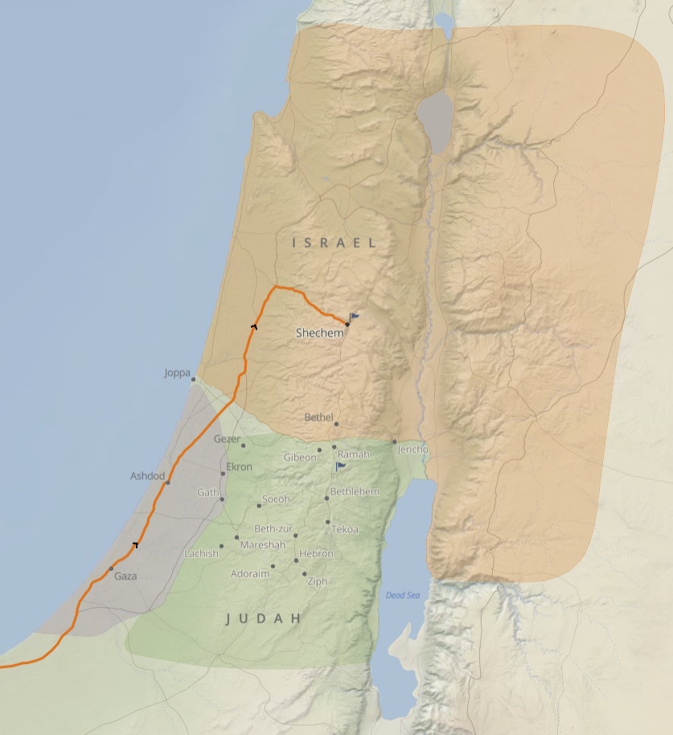
A New Earth. Filled with the Holy Fearful Presence of God.
The world into which Isaiah Prophesied
Great uncertainty; Changing alliances; Rise & fall of world superpowers; Wealth divide.
A divided Kingdom of Judah & Israel (Ephram)
A Messianic Prophecy
A coming King, who would restore the glory-days of a united Israel
A tree cut down, to re-shoot from the stump. Kings of the line of David, cut back to the stump.
The Messiah (Jesus) would bring a completely new Kingdom (Kingdom of God / Heaven)

Slide 10
A New Earth. Filled with the Holy Fearful Presence of God.
The world into which Isaiah Prophesied
Great uncertainty; Changing alliances; Rise & fall of world superpowers; Wealth divide.
A divided Kingdom of Judah & Israel (Ephram)
A Messianic Prophecy
A coming King, who would restore the glory-days of a united Israel
A tree cut down, to re-shoot from the stump. Kings of the line of David, cut back to the stump.
The Messiah (Jesus) would bring a completely new Kingdom (Kingdom of God / Heaven)
When Jesus Returns. A King like no other
The Spirit of YHWH God shall rest upon Him
Wisdom; Understanding; Counsel; Might;
Knowledge of YHWH; Fear of YHWH; Delight in the fear of God
One who judges with complete justice & fairness. Unswayed by appearances.
and he shall strike the earth with the rod of his mouth,
Godly justice = the wicked will be punished
Delight in the fear of God
Sin is the rejection of God. (No delight in the fear of God)
As we repent of sin and submit to Jesus as Lord, our sins are taken away.
Now Children of God. A delightful embracing of the holiness & unapproachability of God
The Kingdom of God comes in all of its fulness
Laws of nature upended.
No violence; No death; No apex predators attacking the weak and vulnerable

Slide 11
A New Earth. Filled with the Holy Fearful Presence of God.
The world into which Isaiah Prophesied
Great uncertainty; Changing alliances; Rise & fall of world superpowers; Wealth divide.
A divided Kingdom of Judah & Israel (Ephram)
A Messianic Prophecy
A coming King, who would restore the glory-days of a united Israel
The Messiah (Jesus) would bring a completely new Kingdom (Kingdom of God / Heaven)
When Jesus Returns. A King like no other
The Spirit of YHWH God shall rest upon Him
Wisdom; Understanding; Counsel; Might;
Knowledge of YHWH; Fear of YHWH; Delight in the fear of God
One who judges with complete justice & fairness. Unswayed by appearances.
Godly justice = the wicked will be punished
Delight in the fear of God
Sin is the rejection of God. (No delight in the fear of God)
As we repent of sin and submit to Jesus as Lord, our sins are taken away.
Now Children of God. A delightful embracing of the holiness & unapproachability of God
The Kingdom of God comes in all of its fulness
Laws of nature upended.
No violence; No death; No apex predators attacking the weak and vulnerable
The Earth full of the Knowledge of God, like the sea is full of water.

Slide 12
A New Earth. Filled with the Holy Fearful Presence of God.
Revelation 21:1–7 (ESV)
21 Then I saw a new heaven and a new earth, for the first heaven and the first earth had passed away, and the sea was no more. ² And I saw the holy city, new Jerusalem, coming down out of heaven from God, prepared as a bride adorned for her husband. ³ And I heard a loud voice from the throne saying, “Behold, the dwelling place of God is with man. He will dwell with them, and they will be his people, and God himself will be with them as their God. ⁴ He will wipe away every tear from their eyes, and death shall be no more, neither shall there be mourning, nor crying, nor pain anymore, for the former things have passed away.”
⁵ And he who was seated on the throne said, “Behold, I am making all things new.” Also he said, “Write this down, for these words are trustworthy and true.” ⁶ And he said to me, “It is done! I am the Alpha and the Omega, the beginning and the end. To the thirsty I will give from the spring of the water of life without payment. ⁷ The one who conquers will have this heritage, and I will be his God and he will be my son.

Slide 13
A New Earth. Filled with the Holy Fearful Presence of God.
The world into which Isaiah Prophesied
Great uncertainty; Changing alliances; Rise & fall of world superpowers; Wealth divide.
A divided Kingdom of Judah & Israel (Ephram)
A Messianic Prophecy
A coming King, who would restore the glory-days of a united Israel
The Messiah (Jesus) would bring a completely new Kingdom (Kingdom of God / Heaven)
When Jesus Returns. A King like no other
The Spirit of YHWH God shall rest upon Him
Wisdom; Understanding; Counsel; Might;
Knowledge of YHWH; Fear of YHWH; Delight in the fear of God
One who judges with complete justice & fairness. Unswayed by appearances.
Godly justice = the wicked will be punished
Delight in the fear of God
Sin is the rejection of God. (No delight in the fear of God)
As we repent of sin and submit to Jesus as Lord, our sins are taken away.
Now Children of God. A delightful embracing of the holiness & unapproachability of God
The Kingdom of God comes in all of its fulness
Laws of nature upended.
No violence; No death; No apex predators attacking the weak and vulnerable
The Earth full of the Knowledge of God, like the sea is full of water.
All evil will be stripped away and the goodness of God floods in
Judgment – Reject God now is to reject eternal life on God-filled Earth.
Embracing Messiah Jesus & His Kingdom
Not improving this world – a completely new one

